Slide 1
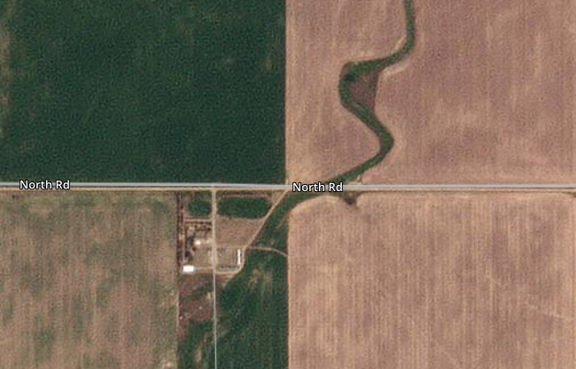
2023 Vida spring wheat
2023 SW fallow
2023 SW fallow
0
0.25 Miles

